Slide 1
A Semantics Aware Random Forest for Text Classification
ADVISOR:JIA-LING KOH
SOURCE:CIKM ’19
SPEAKER:LI-WEI LiU
DATA:2020/02/03

Slide 2
OUTLINE
Introduction
Method
Experiment
Conclusion

Slide 3
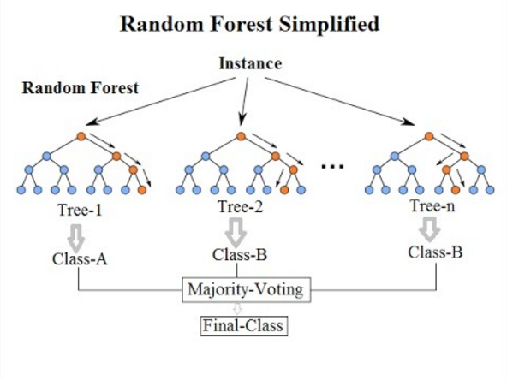
INTRODUCTION
Random Forest(RF):
A classifier containing multiple decision trees.
Via majority voting of the predictions of all the trees in the forest.
Notes:
隨機生成多個決策樹
使用多數決來預測結果
因為是隨機生成，所以會包含不可靠的決策樹，以及高度依賴訓練資料

Slide 4
INTRODUCTION
Random Forest(RF):
Randomly sampling from training data
Randomly selecting features to build a decision tree
Potential problems:
Unreliable decision trees.
Highly dependent on training data set.
Notes:
隨機生成多個決策樹
使用多數決來預測結果
因為是隨機生成，所以會包含不可靠的決策樹，以及高度依賴訓練資料

Slide 5
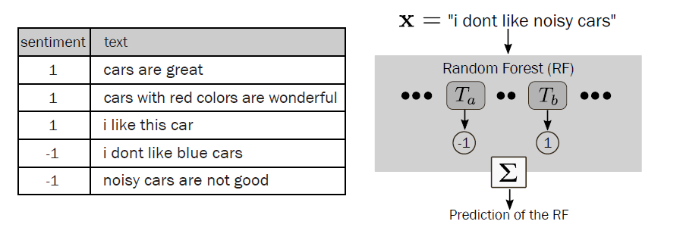
INTRODUCTION
Text classification in RF
Notes:
以這篇主要解決的Text classification為例
Ta:-1 Tb:1

Slide 6
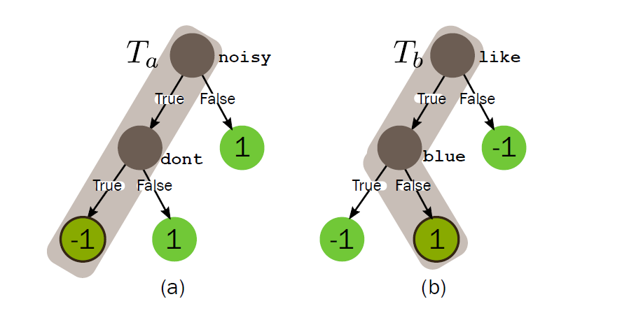
INTRODUCTION
T_{a} predicts the -1 class due to the features {noisy, dont}
T_{b} predicts the 1 class due to the features {like, blue}.
x= "i dont like noisy cars".
The prediction of 1 considering {like, blue}
is not reliable.
Notes:
可以發現Ta的feature只出現-1，而Tb的feature like在兩個class的出現過，甚至blue是出現在-1
那我們可以認為Tb這顆決策樹是不可靠的

Slide 7
INTRODUCTION
Dynamic ensemble selection(DES):
Dynamic selection strategy
Select trees from the validation set
EX: DESP, selects the decision trees achieving performances more than 0.5, select it and combine the answers with a majority voting

Slide 8
INTRODUCTION
DESP:
Select K neighbors
A Decision Tree
Accuracy>0.5
Validation data
Most like
testing data
Predict
Combined Answer
But, this method may not be effectively optimized

Slide 9
INTRODUCTION
Semantics Aware Random Forest(SARF):
Dynamic ensemble selection (DES) method
Choice decision tree by measuring explanatory features.
Semantic explanations behind the predictions to select the reliable predictions for each instance.
Notes:
為了解決隨機生成遇到的問題，作者提出一個新的方法 Semantics Aware Random Forest，以下簡稱SARF
DES:簡單來說，選擇可以達到最高預測準確度的組合
explanatory features解釋性特徵
Semantic explanations 語義解釋

Slide 10
OUTLINE
Introduction
Method
Experiment
Conclusion

Slide 11
SARF Semantics Aware Random Forest
Remain
reliable prediction
Notes:
輸入一篇文本以及他的類別，在RF的所有決策樹中去找出我們要保留的決策樹組合。
對於這個instance X，從每個決策樹提取出的可解釋性的特徵組合，再去計算其是否可靠(就是要不要保留)，最後再結合成最終的RF model，並且預測
預測公式y*前面有提過

Slide 12
METHOD
Explanatory Feature Extraction:
We want to extract e_{t} for a prediction φ_{t} ,
where e_{t} = {ω₁,ω₂, . . . ,ω_{l} }
Notes:
我們要對每個決策樹去提取可解釋性的文字組合et
LIME:
LIME使用轉換函數將原始要素空間轉換為可解釋的空間，以使返回的要素有意義。但是，在本文中，我們考慮了詞袋模型表示，因此特徵是不言自明的，即不需要特徵變換。

Slide 13
METHOD
Explanatory Feature Extraction:
LIME: LOCAL INTERPRETABLE MODEL-AGNOSTIC EXPLANATIONS[28]
LIME determines e_{t} using the coefficients of a linear model fitted to a new dataset(Given a trained treeT_{t} and instance x)
The e_{t} is selected using Lasso
The fetures extracted by LIME are more than 90% similar to the features in the decision paths
Notes:
我們要對每個決策樹去提取可解釋性的文字組合et
LIME:
LIME使用轉換函數將原始要素空間轉換為可解釋的空間，以使返回的要素有意義。但是，在本文中，我們考慮了詞袋模型表示，因此特徵是不言自明的，即不需要特徵變換。

Slide 14
METHOD
Reliability Measurement:
First,we define a relevance function ρ ( e_{t} , k ) → R⁺
How to calculate? EX:...
di:
d1
d2
d3
d4
d5
e_{a} {noisy, dont}
e_{b} {like, blue}
x= "i dont like noisy cars".
k
Notes:
Ρ :念rho
提取完可解釋性feature後，relevance function 計算相關分數R+，怎麼計算下一張詳談
There are K such relevance scores {ρ(e_{t} , 1), ρ(e_{t} , 2), . . . , ρ(e_{t} ,K)}.
τ_{t} ( T_{t} , φ_{t} ) =1 :當φ_{t} 等於 K個ρ ( e_{t} , k )中最相關的 (相關分數最高者)

Slide 15
METHOD
Reliability Measurement:
Step1:
TF_{w,di,k} : The frequency of word w appearing in document di which in class k
TF_{noisy,d5,-1}
di:
d1
d2
d3
d4
d5
TFIDF_{noisy,d5,-1} =(1+log(1/5)*log(1+2/1))
TFIDF_{like,d3,1} =(1+log(1/4)*log(1+3/1))
k
Notes:
Ρ :念rho
提取完可解釋性feature後，relevance function 計算相關分數R+，怎麼計算下一張詳談
There are K such relevance scores {ρ(e_{t} , 1), ρ(e_{t} , 2), . . . , ρ(e_{t} ,K)}.
τ_{t} ( T_{t} , φ_{t} ) =1 :當φ_{t} 等於 K個ρ ( e_{t} , k )中最相關的 (相關分數最高者)

Slide 16
METHOD
Reliability Measurement:
Step2:
TFIDF_{noisy,-1} = TFIDF_{noisy,d4,-1}+ TFIDF_{noisy,d5,-1}
TFIDF_{like,1} = TFIDF_{like,d1,1}+ TFIDF_{like,d2,1}+ TFIDF_{like,d3,1}
e_{a} {noisy, dont}
e_{b} {like, blue}
ρ ( e_{a} , -1 ) = TFIDF_{noisy,-1}+ TFIDF_{dont,-1}
ρ ( e_{b} , 1 ) = TFIDF_{like,1}+ TFIDF_{blue,1}
Step3:
Notes:
Ρ :念rho
提取完可解釋性feature後，relevance function 計算相關分數R+，怎麼計算下一張詳談
There are K such relevance scores {ρ(e_{t} , 1), ρ(e_{t} , 2), . . . , ρ(e_{t} ,K)}.
τ_{t} ( T_{t} , φ_{t} ) =1 :當φ_{t} 等於 K個ρ ( e_{t} , k )中最相關的 (相關分數最高者)

Slide 17
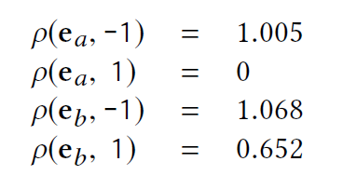
METHOD
Final,we can get ρ ( e_{t} , k ) → R⁺ in our example:
And reliability function is:
τ_{a}( T_{a},φ_{a} ) = 1 & τ_{b}( T_{b},φ_{b} ) = 0
We use result of ρ ( e_{t} , k ) to get τ_{t} ( T_{t} , φ_{t} ),
→ we get the set of reliable predictions Φx
Notes:
Ρ :念rho
提取完可解釋性feature後，relevance function 計算相關分數R+，怎麼計算下一張詳談
There are K such relevance scores {ρ(e_{t} , 1), ρ(e_{t} , 2), . . . , ρ(e_{t} ,K)}.
τ_{t} ( T_{t} , φ_{t} ) =1 :當φ_{t} 等於 K個ρ ( e_{t} , k )中最相關的 (相關分數最高者)

Slide 18
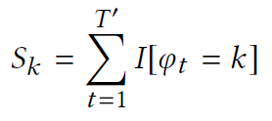
METHOD
Prediction Combination:
MV combination method
If ties…
EX: If we only have 2 decision tree(T_{a},T_{b}),
S₁=1(T_{b})&S₋₁=1(T_{a}), and ρ ( e_{b} , 1 ) = 1.021 & ρ ( e_{a} , -1 ) = 1.062
Count remained decision tree’s I[]
S’₁=1.021
S’₋₁=1.062
Notes:
T’:Φx所保留的決策樹數量
Sk:使用多數決結合結果，計算每個類別的Sk
如果平手,我們計算對應於同一類別k的et的平均相關分數。
每個類別k都計算完Sk後，利用多數決計算出y*

Slide 19
METHOD
Prediction Combination:
Use MV to count which τ_{t} is in Φx
In our example,y*=-1
Notes:
T’:Φx所保留的決策樹數量
Sk:使用多數決結合結果，計算每個類別的Sk
如果平手,我們計算對應於同一類別k的et的平均相關分數。
每個類別k都計算完Sk後，利用多數決計算出y*

Slide 20
OUTLINE
Introduction
Method
Experiment
Conclusion

Slide 21
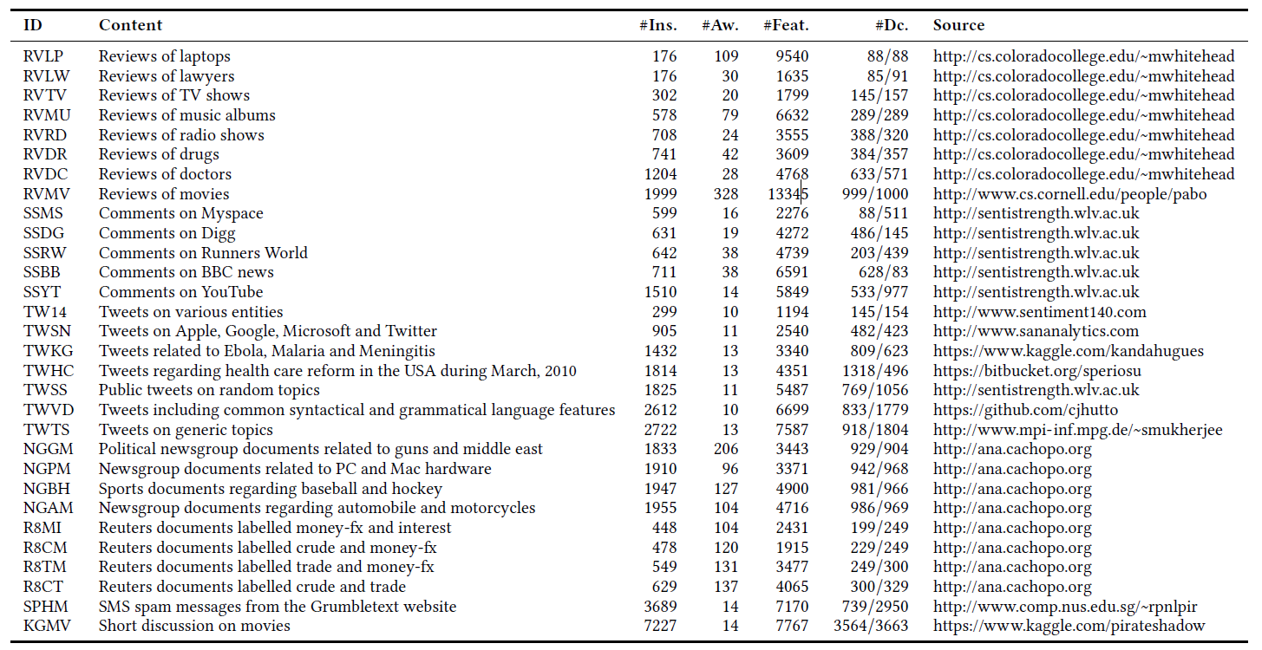
EXPERIMENT DataSets
Notes:
作者在30種不同的資料集進行實驗
#Ins. document的數量
#Aw. 平均字數
#Feat. feature的數量(vocabulary size)
#Dc. 類別分佈(1/0)

Slide 22
EXPERIMENT
Dataset preparation:
Remove the punctuations、stop words、hash-tags、emojis and URLs
T=200 (number of trees)
We experimented with a different number of words (to be returned by LIME) for e_{t} and choose to use 6, 8 or 10 depending on the number of average words per instance in the dataset.
We set the level of significance α = 0.05 i.e., at 95% confidence level.
Notes:
移除標點符號、停用字、hash-tags、表情符號、網址
本篇樹的數量T設為200 (效果比300、500好)
對於不同平均字數的資料，et的size落在6 8 10
重要程度a設為0.05

Slide 23
EXPERIMENTResult and Discussion
SARD achieved the est results on 20 out of 30 text datasets
K=7
Threshold=0.5
…
Notes:
KNORA的兩者類似於KNN
KNORAU:至少對一個的樹就保留，結合時用正確鄰居數加權重的MV
KNORAE:消除準確率低於100%的樹，再用MV combined
DESP:使用DES 再用MV結合結果
METADES:能力得分高於預設的門檻值的決策樹使用加權MV方法進行組合，其中根據能力得分分配權重。
DESMI:使用在多種且不平衡的數據集的DES，並透過加權MV方法結合，強調tree在少數class的能力
MicroF1:看整體的F1
MacroF1:每個類別的F1取平均
在大部分的資料顯示SARF的表現最好，但有些分類器在一些資料上也能表現得很好
尤其R8CM，所有分類器都有好的表現，甚至贏過SARF

Slide 24
EXPERIMENTWilcoxon signed-rank test
Wilcoxon signed-rank test → Calculate absolute value of distance to rank
example:
DESMI SARF Absolute value of distance
A. MicroF1=0.8, MicroF1=0.82 │0.8-0.82 │=0.02
B. MicroF1=0.9, MicroF1=0.82 │ 0.9-0.82│=0.08
C. MicroF1=0.7, MicroF1=0.82 │ 0.7-0.82│=0.12
Rank: A:1(R⁻),B:2(R⁺),C:3(R⁻)
So… R⁺ R⁻
DESMI vs. SARF 2 4

Slide 25
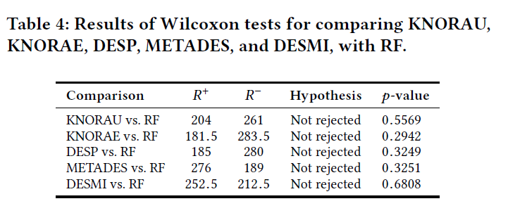
EXPERIMENTResult and Discussion
We can conclude that applying KNORAU, KNORAE,DESP, METADES and DESMI DES methods do not improve the performance of the RF classifier.
Notes:
p-value(機率密度值)小於0.05被認為是確定實驗數據可靠性的金標準

Slide 26
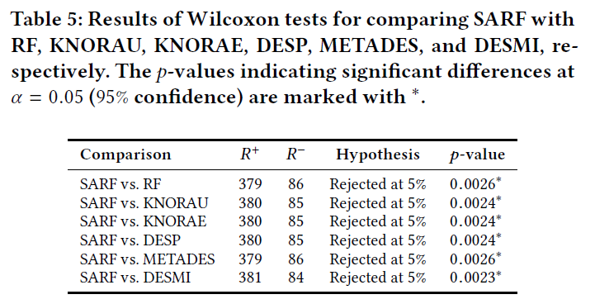
EXPERIMENTResult and Discussion
p-values are lower than α(0.05).
Notes:
p-value(機率密度值)小於0.05被認為是確定實驗數據可靠性的金標準
p-value小於0.05->拒絕虛無假設(SARF跟該方法相等表現)->所以代表SARF表現較好

Slide 27
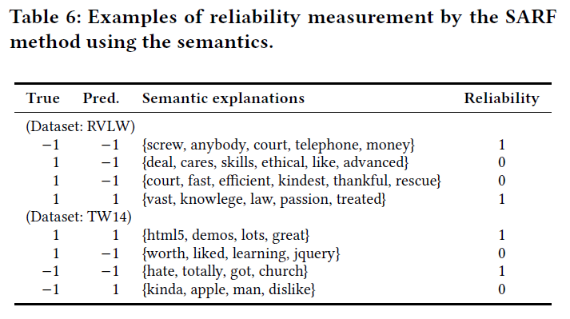
EXPERIMENTResult and Discussion
True=Pred.→Reliability=1, the corresponding semantic explanations with reliability
Notes:
Reliability=1,代表該可解釋性的語意是可靠的
RVLW的第2筆資料:{cares,skill,ethical,like,advanced}都是正面詞而他卻預測-1

Slide 28
OUTLINE
Introduction
Method
Experiment
Conclusion

Slide 29
CONCLUSION
We present a new method(SARF) to improve the performance of the prominent RF classifiers for text classification.
Semantics Aware Random Forest method uses the semantic explanations of the predictions to determine their interpretability.
The proposed method achieves statistically significant improvement over the traditional RF as well as existing DES methods.
In future, we aim to extend the concept of reliability measure to other ensemble algorithms in order to increase their performance.

